Slide 1



Slide 2

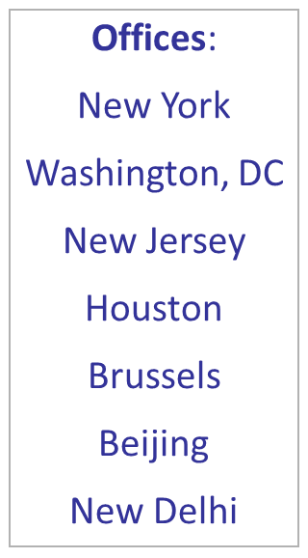
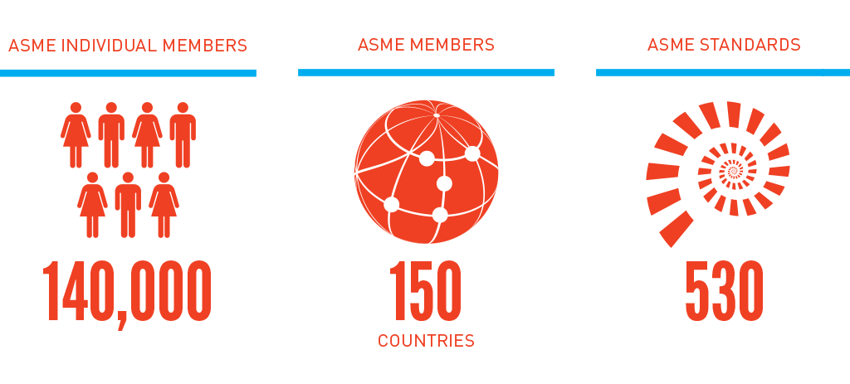
Founded in 1880 as the American Society of Mechanical Engineers

Slide 3
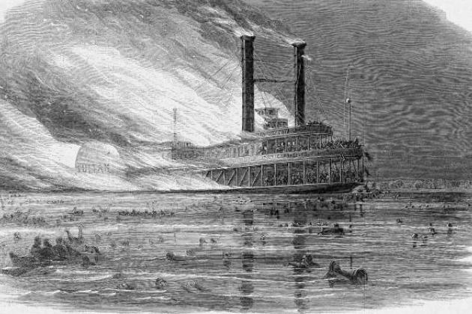
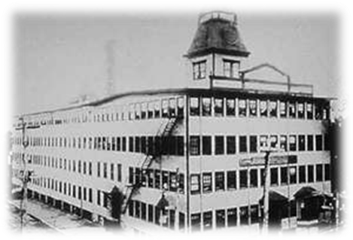
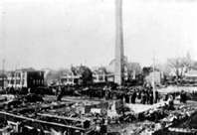
Pivotal Events in ASME’s History
  The SS Sultana An estimated 1,800 of the Sultana's 2,400 passengers were killed when three of the ship's four boilers exploded. 1865
The 1905 Grover Shoe Factory disaster killed 58 people following a boiler explosion.
This disaster led to passage of a national boiler safety code with leadership from ASME.

Slide 4
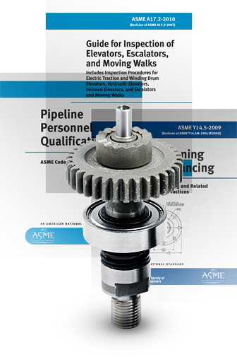
ASME Codes and Standards
Nuclear Plants
Alternative Energy
Fossil Plants
Energy Efficiency
Renewables
Environmental

Slide 5
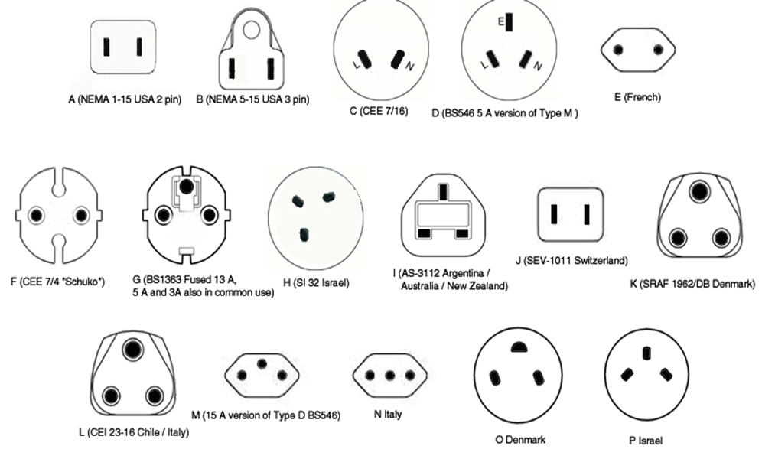
Without consistency of requirements you get this…..

Slide 6
ASME Codes Categories
Nuclear
  Nuclear codes and Standards Sec III & XI
  Standards committee on Cranes for Nuclear facilities
Pressure Technology
  BPVC Sec I, II, IV, IX, V, VIII, X, XII
  B31 Code
  Bioprocessing Equipment (BPE)
Safety
  A17 Elevators and Escalators
  B20 Safety Standards for conveyors and related equipment
  Rail Transit vehicle Standard Committee
Standardization & Testing
  Y14 Engineering Drawings and related documents
  EA Industrial Energy Assessment Standards Committee
  Performance Test Code

Slide 7
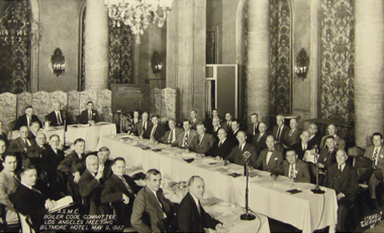
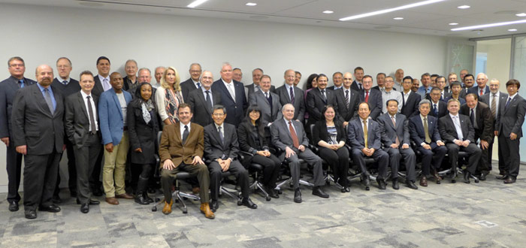
ASME Codes and Standards Development
For Industry by Industry
No commercial motivation or agenda
No funding from government
Supported by revenue from C&S sales and related programs
Volunteer members are not compensated by ASME

Slide 8
Coming June, 2017
ASME Boiler Pressure Vessel Code
ASME issued its first Standard, Code for the Conduct of Trials of Steam Boilers, in 1884.
The BPVC has grown over the decades to include 31 books and 17,000 pages
The BPVC covers industrial and residential boilers as well as nuclear reactor components, transport tanks, and other forms of pressure vessels.
It is kept current by nearly 1,000 volunteer technical experts – drawn from a balance of interests among industry, government and R&D – who operate in a fully open and transparent manner via consensus process.
Section III Subsection NH is no longer a separate book but is now located in Section III Division 5

Slide 9

Nuclear Construction Sections of BPVC
Nuclear Construction Sections of BPVC
Section III - Rules for Construction of Nuclear Facility Components
Section XI - Rules for Inservice Inspection of Nuclear Power Plant Components

Slide 10
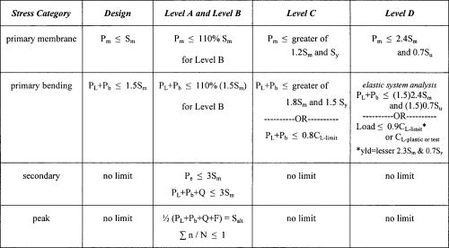
What is Section III?
Section III of the ASME Code Address the rules for construction of nuclear facility components and supports.
The components and supports covered by section III are intended to be installed in a nuclear power system that serves the purpose of producing and controlling the output of thermal energy from nuclear fuel and those associated systems essential to safety of nuclear power system.
Section III provides requirements for new construction of nuclear power system considering mechanical and thermal stresses due to cyclic operation.
Deterioration, which may occur in service as result of radiation effects, corrosion, or instability of the material, is typically not addressed.

Slide 11
BPVC Nuclear Construction Code
Section III-Rules for Construction of Nuclear Facility Components-Division 1-Appendices - This Subsection contains appendices, both mandatory and nonmandatory for Section III, Division 1 (Subsection NCA through NG) and Division 2, including a listing of design and design analysis methods and information, and Data Report Forms. These appendices are referenced by and are an integral part of Subsection NCA through NG and Division 2.
Rules for Construction of Nuclear Facility Components-Division 1-Subsection NB-Class 1 Components Part of fluid-retaining pressure boundary of the reactor coolant system (Pressure vessel, generators pumps)
Subsection NC-Class 2 Component - not part of the reactor coolant pressure boundary, but are important for reactor shutdown
Subsection ND-Class 3 Components - components that are not part of class 1 or 2 but are important to safety
Subsection NE-Class MC Components Supports (Containment Vessel)
Subsection NF-Supports (Plate and Shell Type, linear and standard supports)
Subsection NG-Core Support Structures (Core Support Structures and Reactor Vessel Internals)

Slide 12
Section III Subsection NCA
Subsection NCA (General Requirements for Division 1 and Division 2)
NCA is referenced by and an integral part of Division 1 Subsection NB to NG and Division II of Section III
NCA Covers Quality Assurance requirements, ASME Product certification Marks and authorized inspection of Class 1,2,3 MC, CS and CC Construction (metal containment, core supports and concrete containment)
NCA includes most recent interpretations of Section III
NCA-1000 Scope of Section III
NCA-2000 Classification of Components and Supports
NCA-3000 Responsibilities and Duties
NCA-4000 Quality Assurance
NCA-5000 Authorized Inspection
NCA-8000 Certificates, Nameplates, Code Symbol Stamping, and Data Reports
NCA-9000 Glossary

Slide 13
BPVC Nuclear Construction Code
Section III-Rules for Constructions of Nuclear Facility Components-Subsection NCA-General Requirements for Division 1 and Division 2 - This Subsection covers general requirements for manufacturers, fabricators, installers, designers, material manufacturers, material suppliers, and owners of nuclear power plants. This Subsection which is referenced by and is an integral part of Division 1, Subsections NB through NG, and Division 2 of Section III, covers quality assurance requirements, ASME Product Certification Marks, and authorized inspection for Class 1, 2, 3, MC, CS, and CC construction.
Section III-Rules for Construction of Nuclear Facility Components-Division 2-Code for Concrete Containments - This Division contains requirements for the material, design, construction, fabrication, testing, examination, and overpressure protection of concrete containment structures, pre-stressed or reinforced.
Section III-Rules for Construction of Nuclear Facility Components-Division 3-Containments for Transportation & Storage of Spent Nuclear Fuel & High Level Radioactive Material & Waste - This Division contains requirements for the design and construction of the containment system of a nuclear spent fuel or high level radioactive waste transport packaging.

Slide 14
BPVC Nuclear Construction Code
Section III-Rules for Construction of Nuclear Facility Components-Division 5-High Temperature Reactors - Division 5 of Section III of the BPVC provides construction rules for high-temperature reactors, including both high-temperature, gas-cooled reactors (HTGRs) and liquid-metal reactors (LMRs).
***** Section III-Rules for Construction of Nuclear Facility Components-Division 1-Subsection NH-Class 1 Components in Elevated Temperature Service*****
This subsection will no longer be a stand alone book but will be relocated and incorporated in to Section III Division 5
Section XI - Rules for Inservice Inspection of Nuclear Power Plant Components - Section contains Division 1 and 3, in one volume and provides rules for the examination, inservice testing and inspection, and repair and replacement of components and systems in light water cooled and liquid metal cooled nuclear power plants.
The Division 2 rules for inspection and testing of components of gas cooled nuclear power plants have been deleted in the 1995 Edition.

Slide 15
Section III
Division 3 Containments for Transportation and Storage of Spent Nuclear Fuel and High Level Radioactive Material and Waste
New Subsection WD
ASME Section III, Division 3, addresses the design of transportation and storage containment shells
Does not address the containment internal support structure that holds the spent fuel or high level waste in place.
Subsection WD has been under development for 2 years
Development of Subsection WD, “Internal Support Structures” was deemed necessary because current containment system basket construction is a piecemeal approach using ASME Section III, Division 1, Subsection NF, “Supports” and/or ASME Section III, Division 1, Subsection NG, “Core Support Structures” or some other engineering method.
The issuance of Subsection WD will ensure standardization of future containment baskets, assist the regulatory agency in the review and approval of the baskets, and ensure that the essential criteria in the basket related to spent fuel and high level waste storage transportation and disposal is adequately addressed. The purpose of the basket is primarily to ensure that the radioactive components in the containment are supported in a way as not to create a criticality event.

Slide 16

BPVC Service Sections
Service Sections of BPVC
Section II - Materials
Section V - Nondestructive Examination
Section IX - Welding and Brazing Qualifications

Slide 17
Service Sections of BPVC
Section II-Materials-Part A-Ferrous Materials Specifications (2 Volumes)
Section II-Materials-Part B-Nonferrous Material Specifications
Section II-Materials Part C-Specifications for Welding Rods Electrodes and Filler Metals
Section II-Materials-Part D-Properties-(Customary)
Section II-Materials-Part D-Properties-(Metric)
Section V-Nondestructive Examination - contains requirements and methods for nondestructive examination which are referenced and required by other BPVC Sections. It also includes manufacturer's examination responsibilities, duties of authorized inspectors and requirements for qualification of personnel, inspection and examination.
Section IX-Welding, Brazing, and Fusing Qualifications - contains rules relating to the qualification of welding, brazing, and fusing procedures as required by other BPVC Sections for component manufacture. It also covers rules relating to the qualification and requalification of welders, brazers, and welding, brazing and fusing machine operators in order that they may perform welding, brazing, or plastic fusing as required by other BPVC Sections in the manufacture of components.

Slide 18
Errata
Errata, Code Cases and Interpretations:
Errata to codes and standards are posted on the ASME Web site under the Committee Pages to provide corrections to incorrectly published items, or to correct typographical or grammatical errors in code and standard.
Code Case In the event there is an urgent need for alternative rules concerning materials, construction, or in-service inspection activities not covered by existing Boiler and Pressure Vessel Code rules, or for early implementation of an approved Code revision, ASME may issue a Code Case.
Interpretation ASME issues written replies to inquiries concerning interpretation of technical aspects of the Code.

Slide 19
International Participation
Incorporation of market and governmental needs into ASME codes and standards
ASME encourages international participation in its standards development committees
  Individual Experts
  Delegate Program
  International Interest Review Group (BPV)
  International Review Groups
  Contributing Members
An International Working Group (IWG) accommodates participation by members in a common geographic location who would otherwise be unable to meet the attendance expectations of committees that meet principally in the U.S. and Canada
International participation facilitated by use of electronic tools (C&S Connect) in standards development activity

Slide 20
Conformity Assessment

Slide 21


Conformity Assessment Programs
Product Certification
Quality Program
Certification
Accreditation
Personnel Certification
BPV
Nuclear Component
RTP
BPE
NQA-1
AIA
PRD
GDTP
QRO
ANDE
November
Nuclear Materials

Slide 22
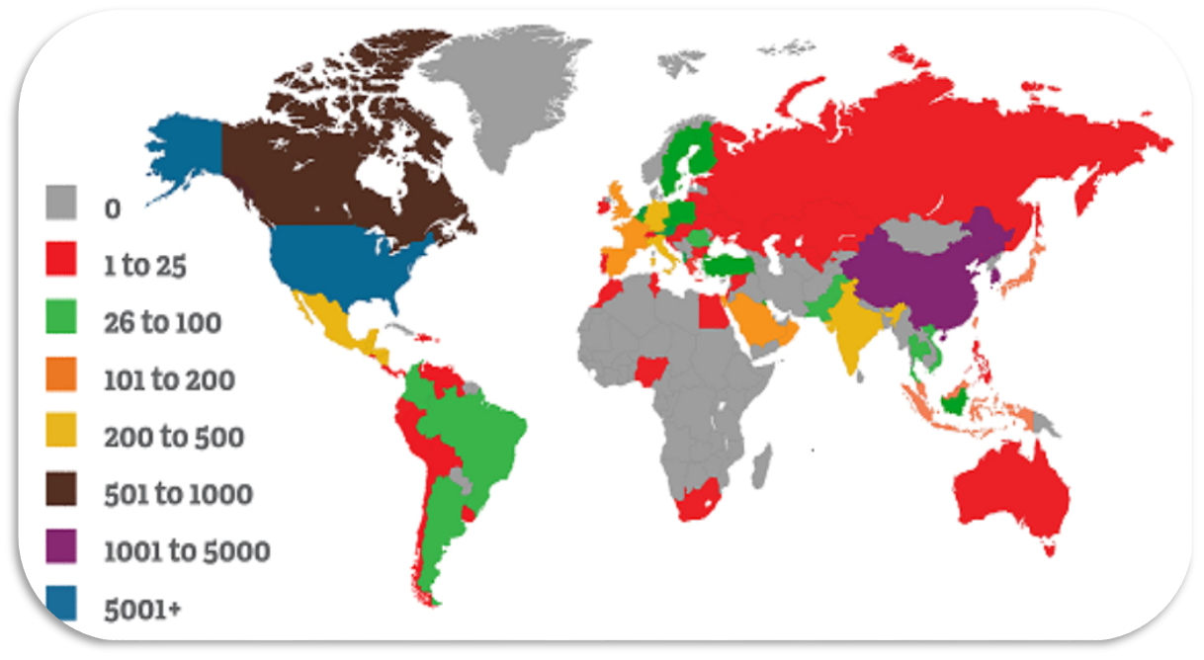
ASME Global Certifications
13,758 certifications
7,740 Certified Companies

Slide 23

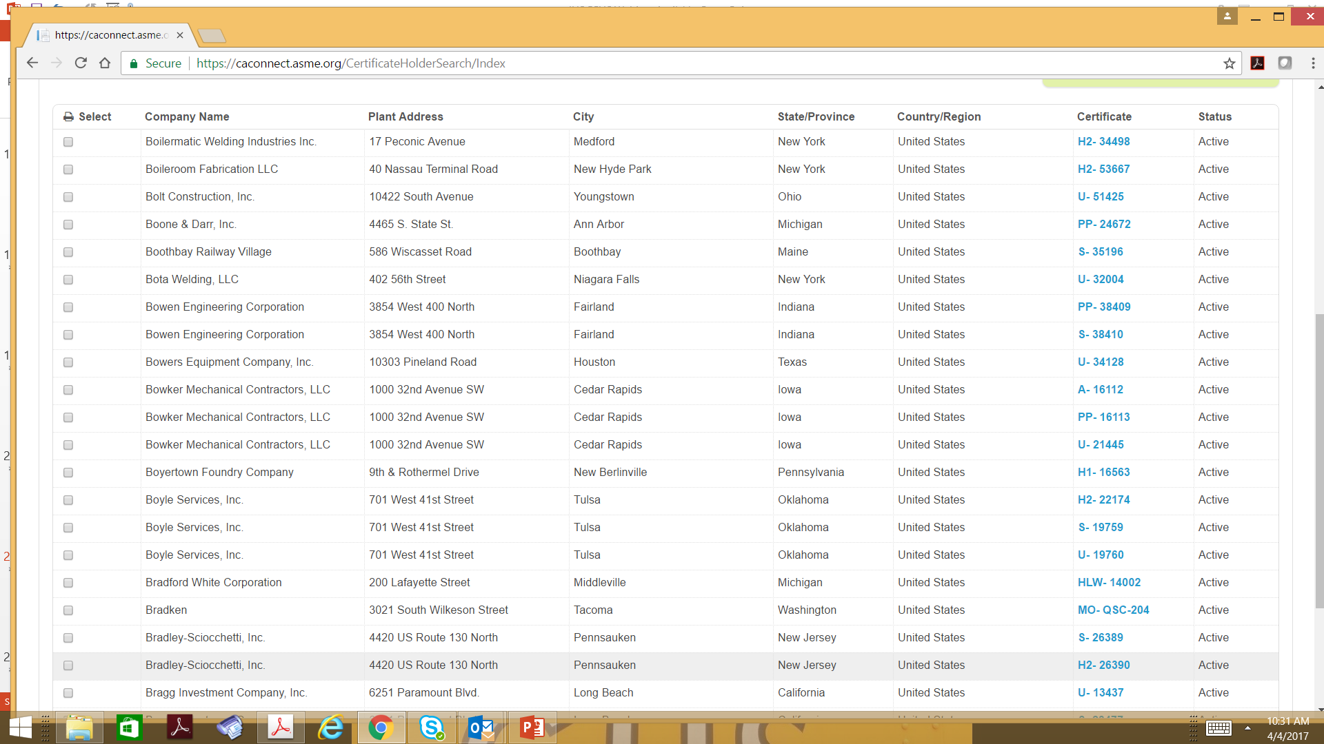
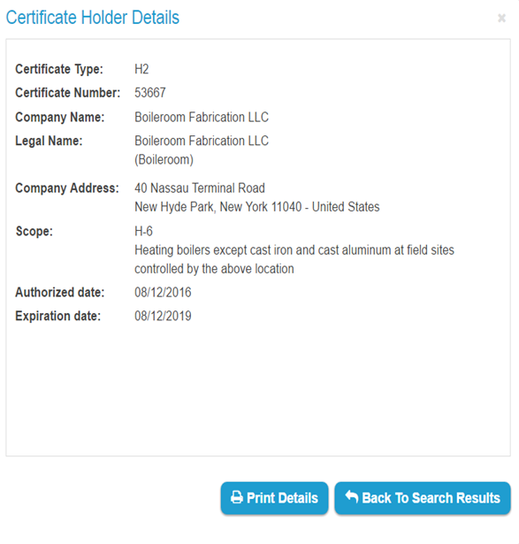
ASME Certification Search

Slide 24


ASME Nuclear Certificates Available
N Vessels, pumps, valves, piping systems, storage tanks, core support structures, concrete containments, and transport packaging
QSC - Nuclear Material Organization Certification
NA - Field installation and shop assembly of all items
ASME Certification
OWN - Nuclear power plant owner
NPT - Parts, appurtenances, welded tubular products, and piping subassemblies
NS – Supports
N3 - Transportation containments and storage containments
NV - Pressure relief valves

Slide 25

Certification
Path to Certification
Submit application
ASME Audit
Internal audit
Selection of AIA
Training
Creation of ASME Nuclear QM and Supporting procedures
Purchase code books
Alignment Nuclear team
ID scope of program
contact an expert

Slide 26

Thank You
Chris Mähler
ASME mahlerc@asme.org
THE AMERICAN SOCIETY OF MECHANICAL ENGINEERS
promotes the art, science & practice of multidisciplinary engineering and allied sciences around the globe.

